Slide 1

EMPLOYEE MANAGEMENT SYSTEM
TEAM 15
SRIDEVI YARAMATI TEJASRI KOPPULA NAGA VAMSI KRISHNA BANDELA MANI SHANKAR REDDY KAMBHAM

Slide 2

Story of the project
Employees are the core of the business, and their management is essential in determining the organizational value.
Everything has been computerized in our age of ever-increasing technologies. The people employment has grown as a result of the growing number of job options.
As a result, there should be a dedicated system that can handle the data of such a vast number of employees.

Slide 3
Data and details
The data in employee management system handles the personal details as well as employee’s organization related details.
Users with specific roles can view the application's content, and employees can perform related operations on their personal details.
Edit the details of an employee
Search for an employee’s details
Update an employee’s details for appraisal or delete the record
View details of an employee’s details

Slide 4

Idea of application of story
Implementation of a MEAN stack web-based employee management system in order to meet needs such as project management module, leave management module, payroll management module, appraisal management module.
This project offers a comprehensive approach to employee data management.

Slide 5
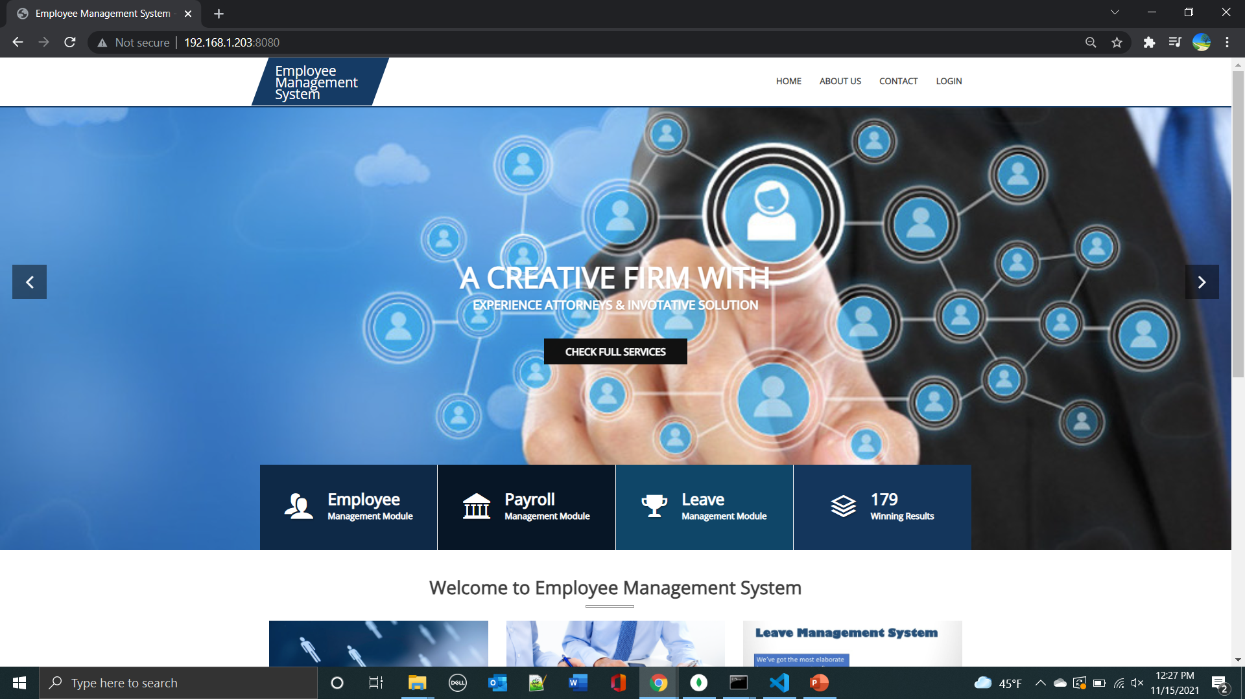
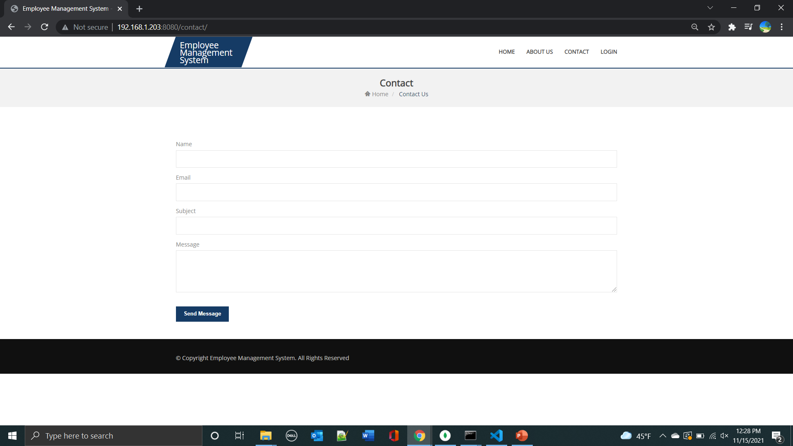
Working Screens

Slide 6
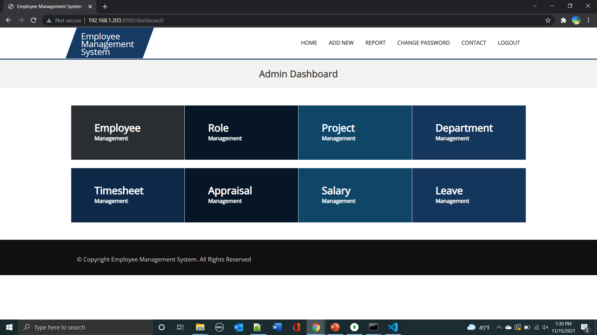
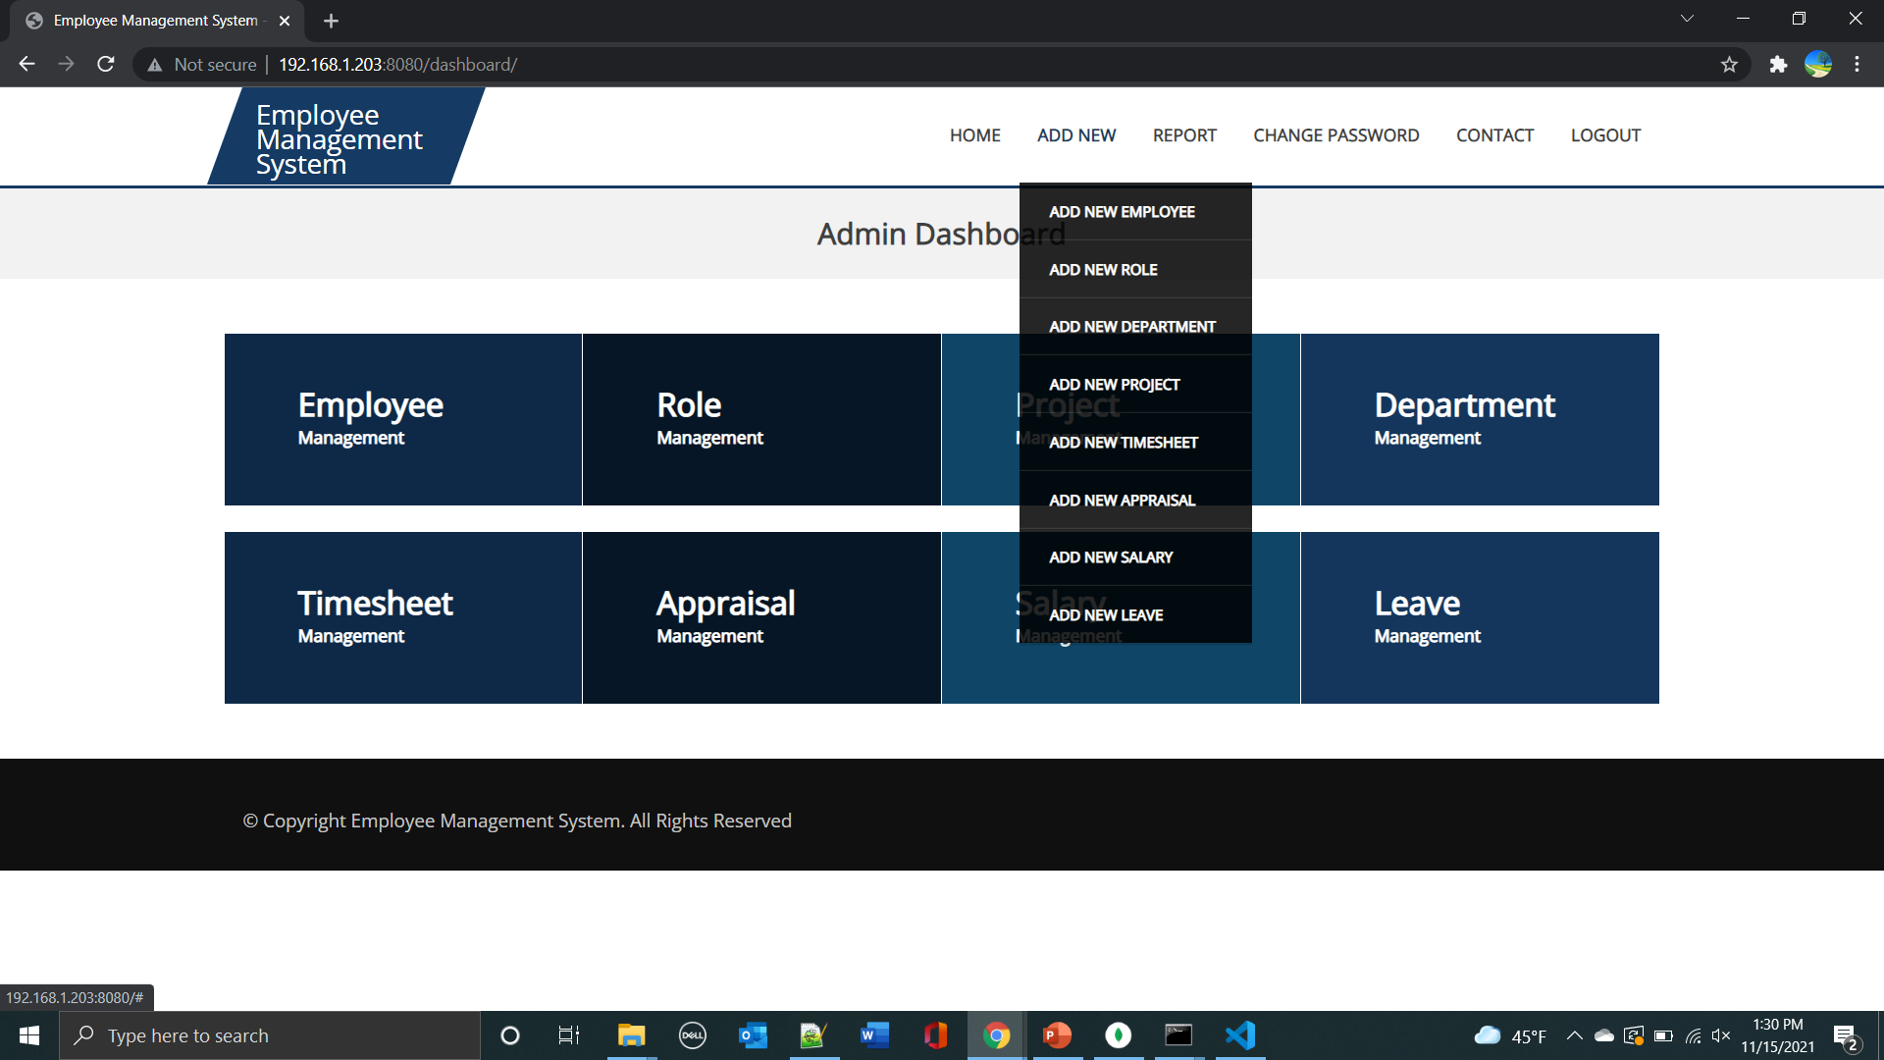
Working Screens

Slide 7
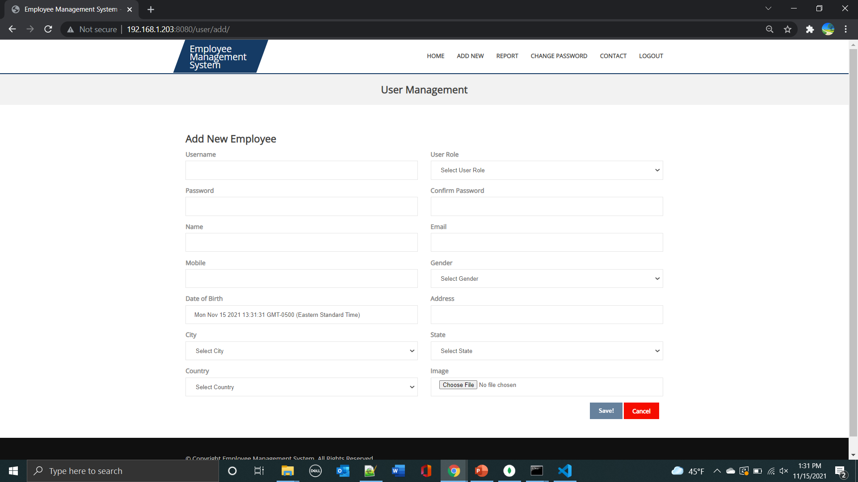
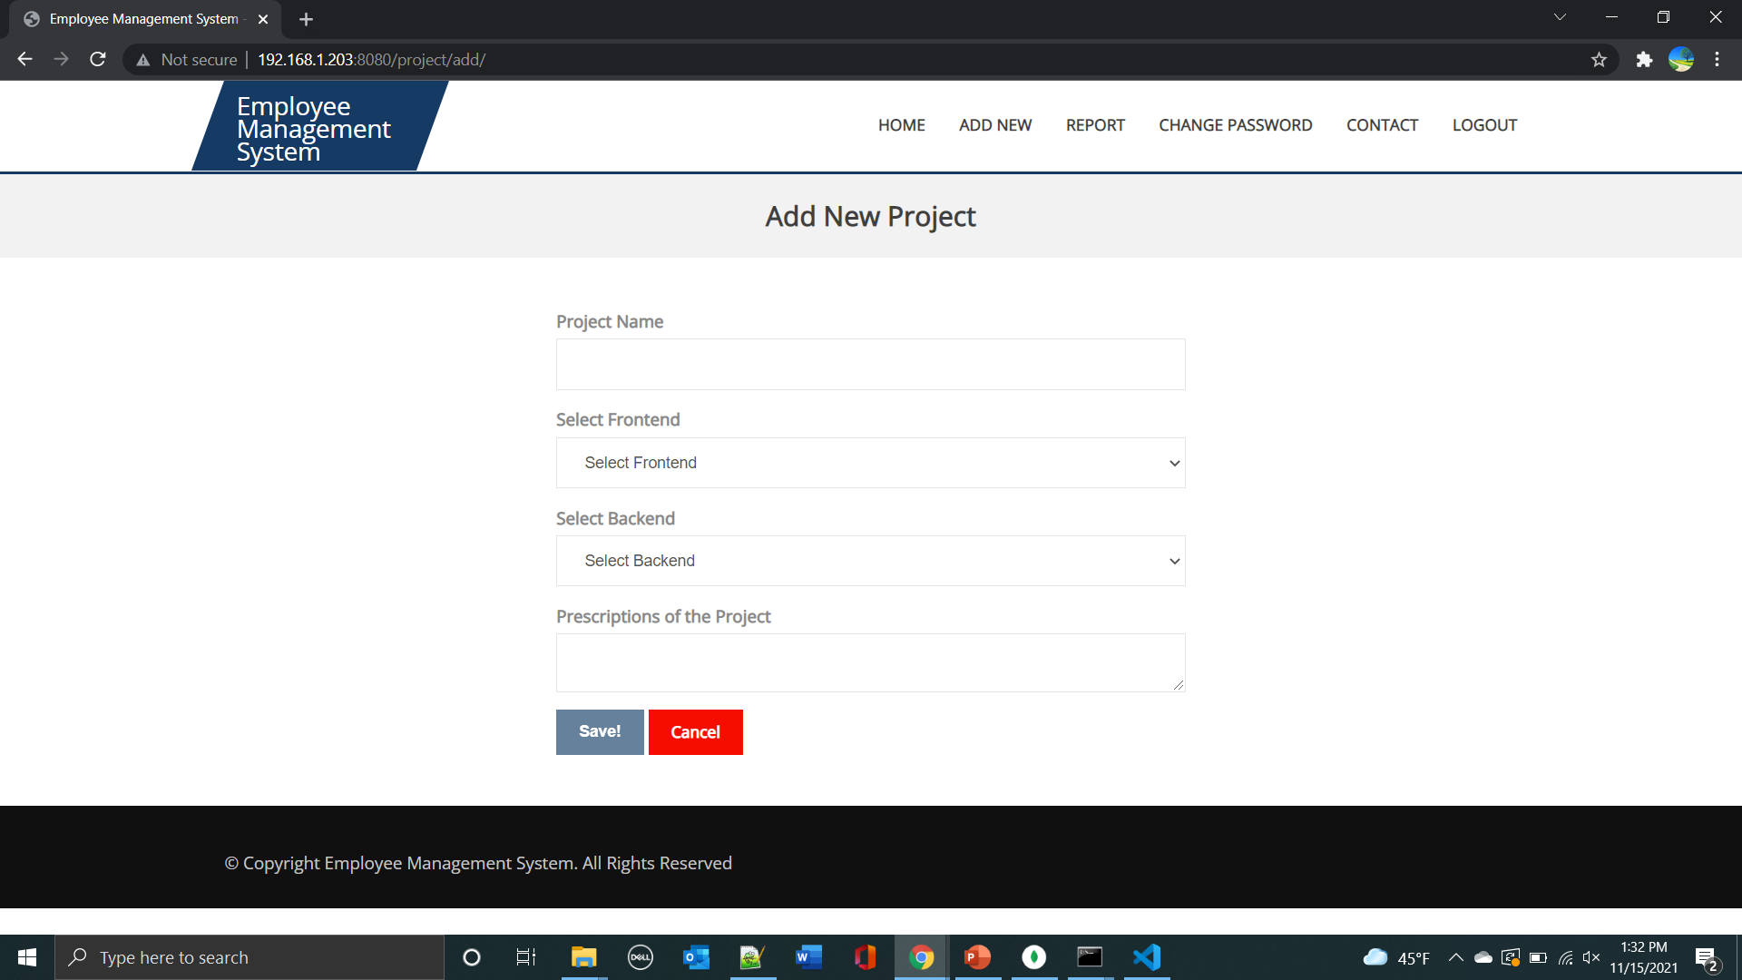
Working Screens

Slide 8
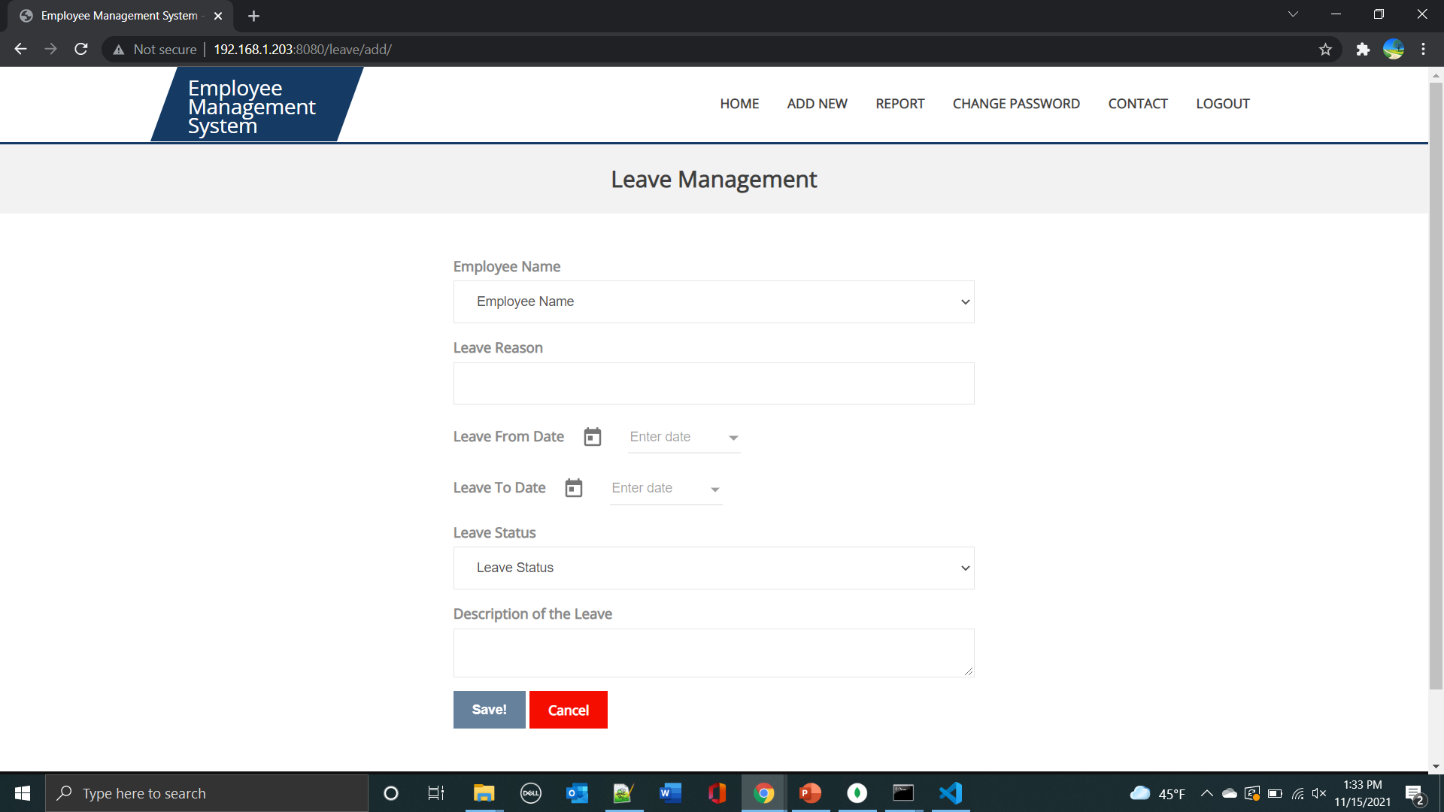
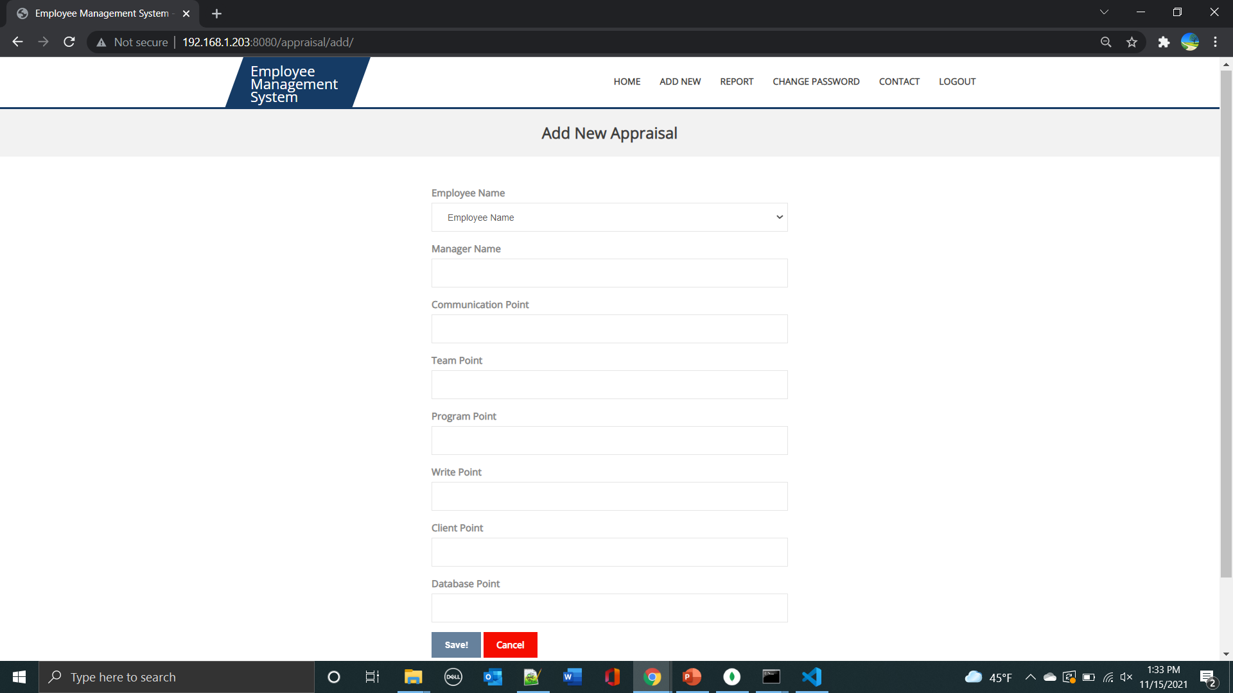
Working Screens

Slide 9
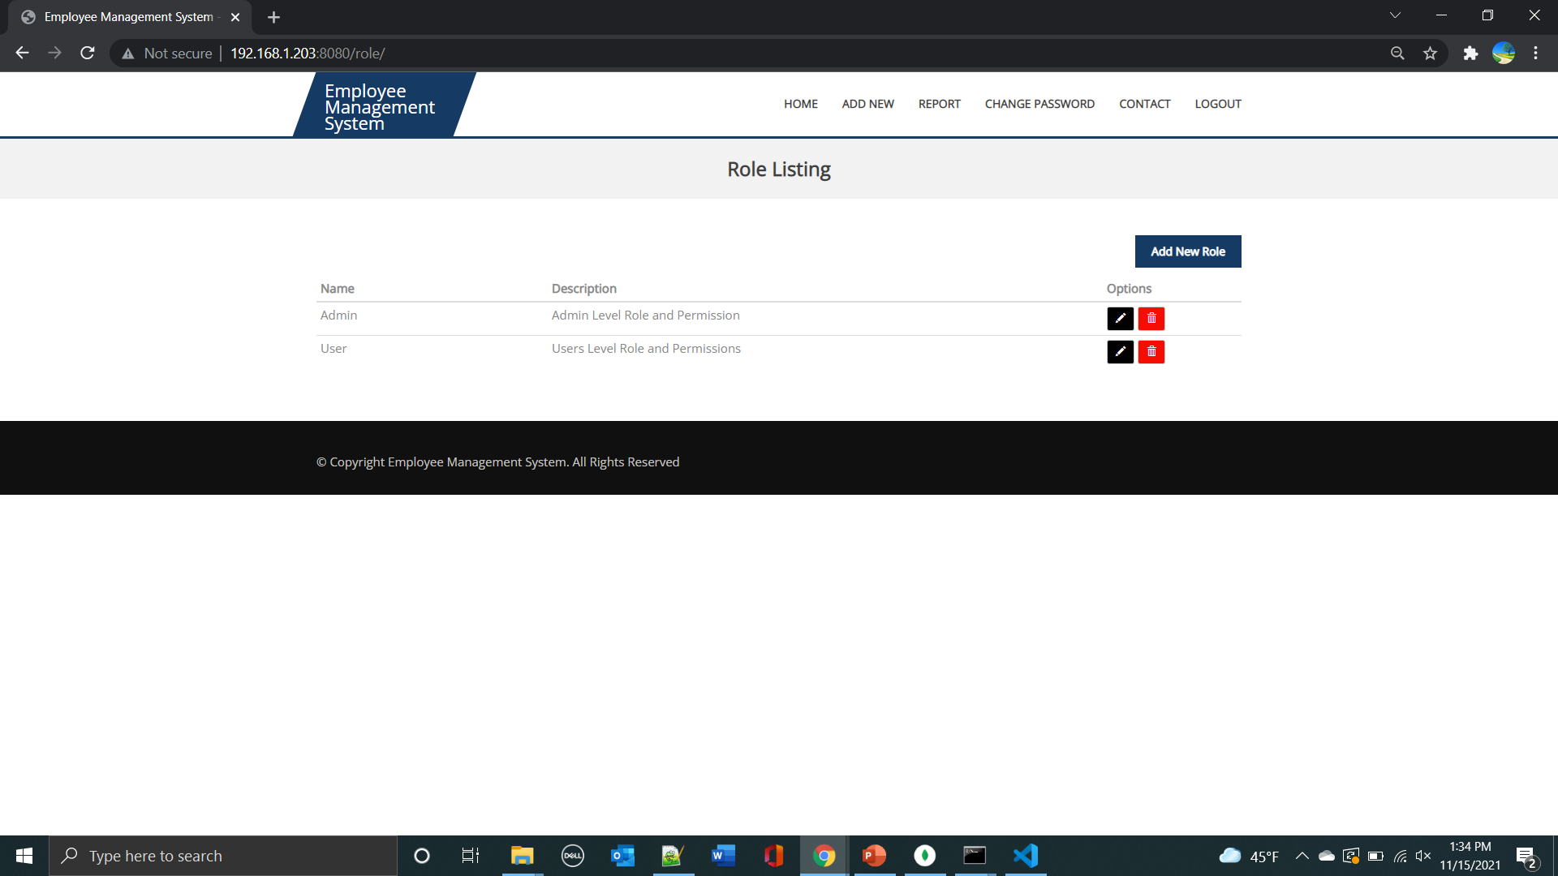
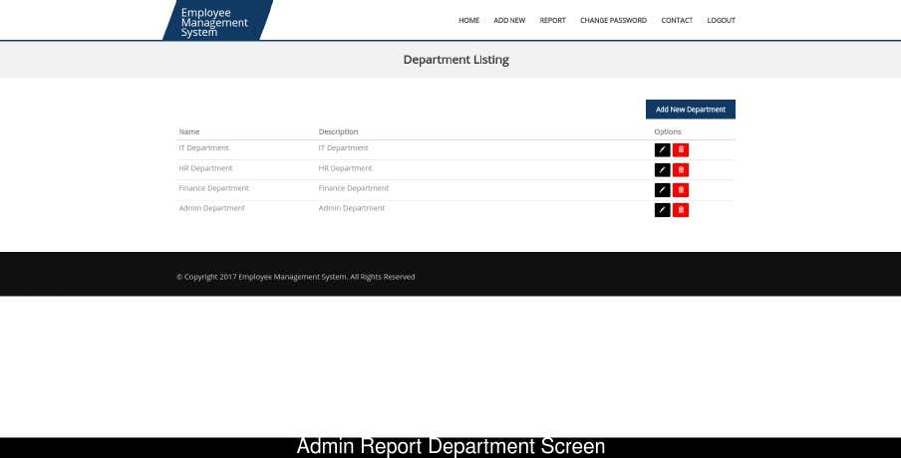
Working Screens

Slide 10
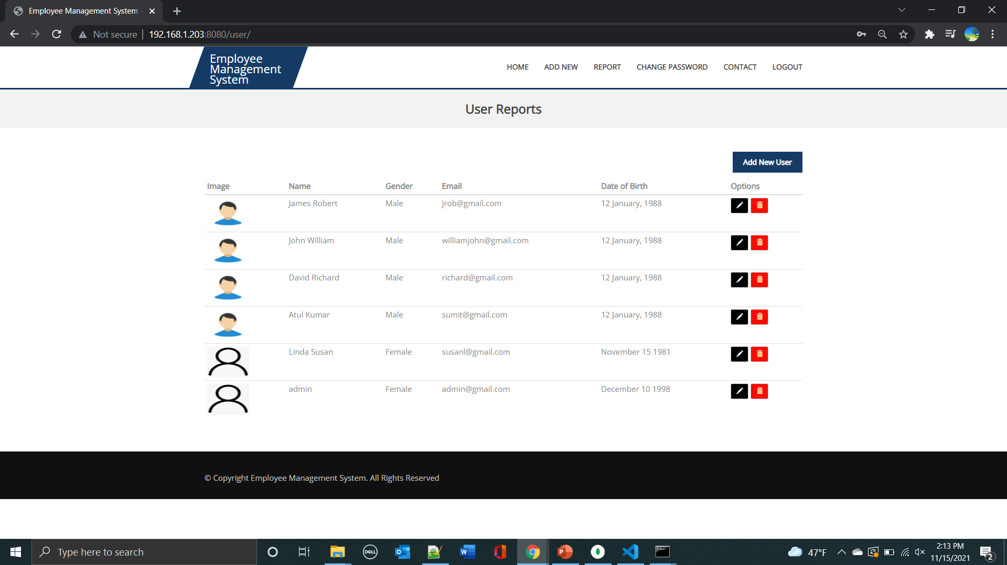
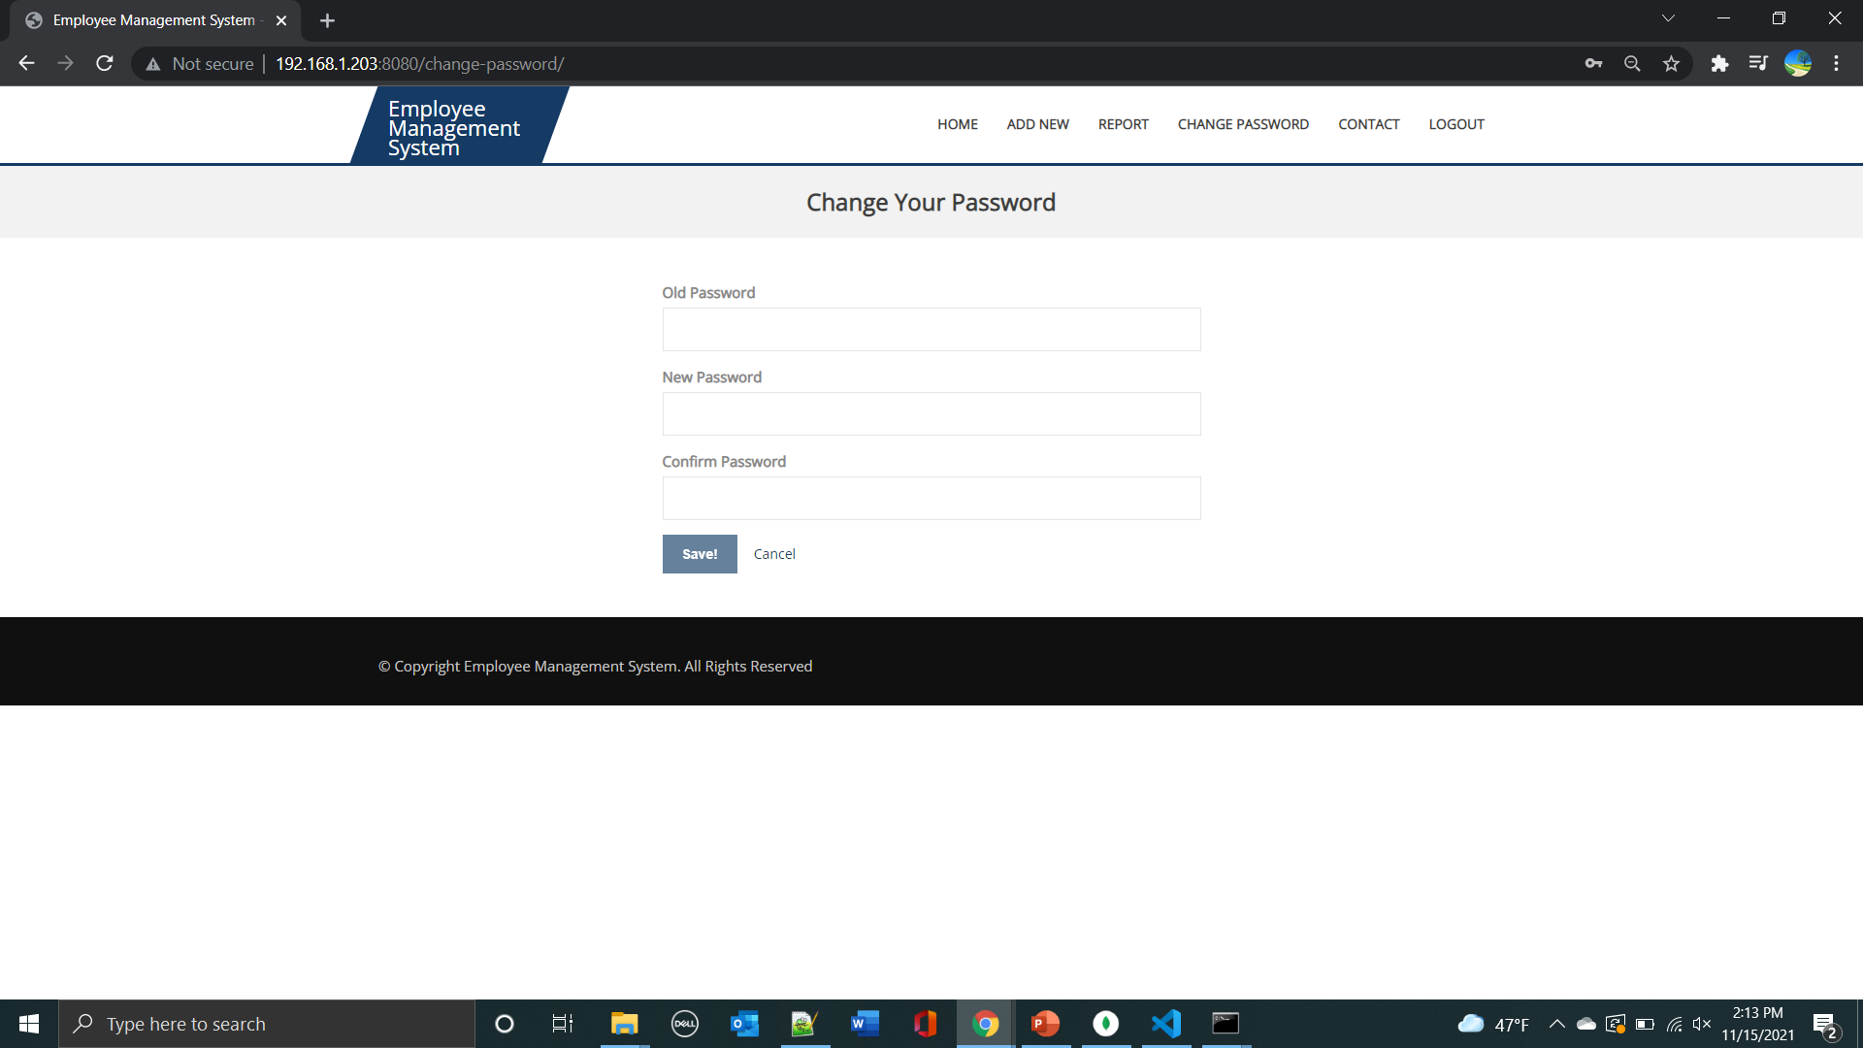
Working Screens

Slide 11
Work Distribution between Teammates
Front-end development of Employee, leave,SALARY modules : Sridevi, Tejasri
Front-end of Appraisal, Login modules and Back-end connections: Vamsi, Mani Shankar
Documentation: All members

Slide 12
GitHub Link
https://github.com/sykhb/Employee-Management-System\

Slide 13
References
https://en.wikipedia.org/wiki/Human_resource_management_system
https://empmonitor.com/blog/employee-management-system/
https://www.pockethrms.com/employee-management-system/
https://docs.angularjs.org/tutorial
https://expressjs.com/
https://nodejs.org/en/docs/
https://getbootstrap.com/docs/4.3/getting-started/introduction/#quick-start
https://docs.mongodb.com/manual/tutorial/
https://bestfreehtmlcsstemplates.com/

Slide 14
THANK YOU

